Slide 1
Pickit Edu in Office 365
A very short presentation about an intriguing offer to complete your educational Office 365 solution.

Slide 2
We want to offer students & teachers free access to Pickit

Slide 3
Imagine an ISV add-in for Microsoft Office 365 that meets a real need everybody has. Schools and universities can get it for free in a matter of minutes. Try it yourself. If you’re in PowerPoint or Word Office 2013 or later, just go to Insert Tab > Store > Pickit.

Slide 4
Today, people communicate in images

Slide 5
Of which about 85%
are illegal

Slide 6
To counteract inappropriate use of visuals in school work, there are really only three ways to go:
1
Ignore the problem until it bites you
2
Reduce access to free media and prohibit behaviour
3
Offer and inspire people to use a better solution
This is where we come in

Slide 7
Goodbye search engines.
Hello Pickit.
Most downloaded app globally in Microsoft AppSource and Office Store 2017

Slide 8
We share our revenue with the image providers and the photographer community.
At Pickit, we’re doing our bit to fix the broken image market. We always reward our photographers and active community members.

Slide 9
Microsoft actually invested in Pickit in Feb 2017. Because they believed in the value we create for Office users.

Slide 10
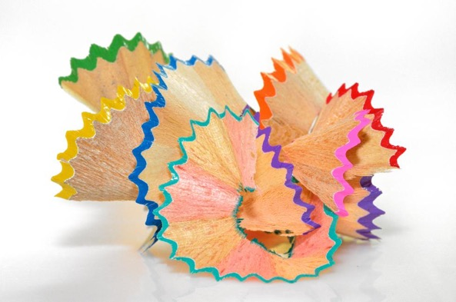
It’s really this easy
Why
How
What
Make the school compliant. Offer students an inspiring alternative to illegal photos.
Increase student productivity in creating docs and presentations.
Your Office Admin centrally deploys the app across the school (done in 3 mins).
Invited students will then automatically have the app icon in the ribbon inside PPT, Word, OneNote and Excel. They just use SSO to get it going.
Students get unlimited access to legal photos, icons and clipart inside the programs they’re already using.
They can search or browse curated collections. Pickit also works amazingly with PowerPoint Designer.

Slide 11
LEGALLY CLEARED
All images inside the Pickit platform are compliant to Microsoft Office standard. Pickit takes responsibility to make sure violent, racy, illegal or otherwise inappropriate content doesn’t feature on the platform. This is handled by our double safety procedure. First we use vision API automatic screening. Secondly we use manual human curation. All users need to know is that all visuals provided by Pickit are licensed, legally cleared, and free to use for anything.

Slide 12
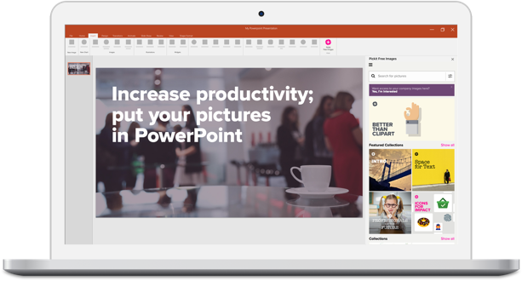
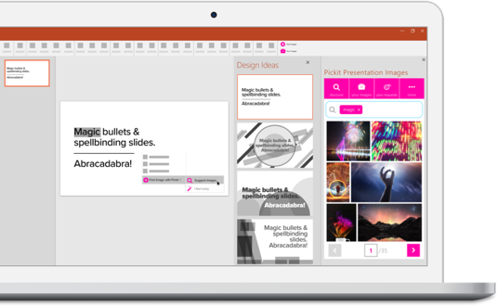
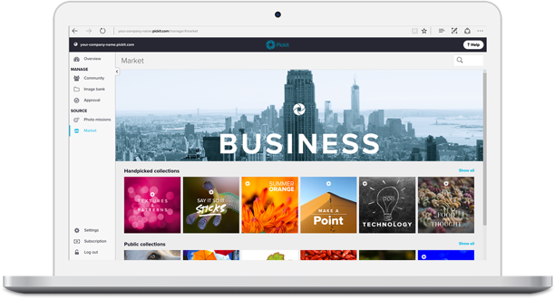
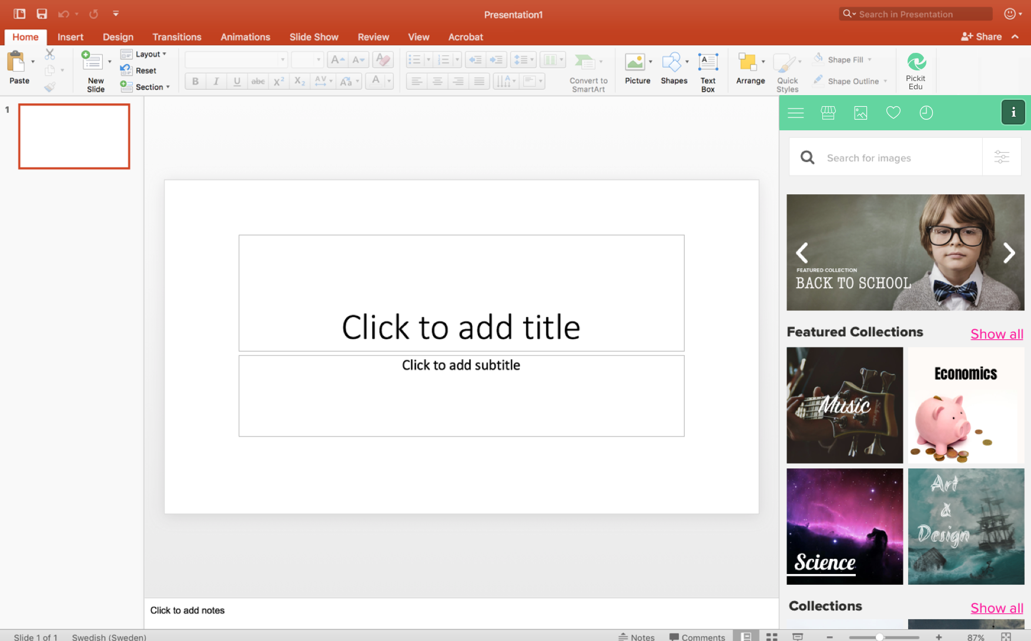
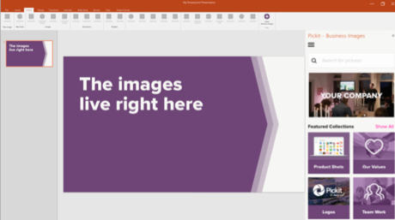
Pickit now comes in 3 versions
Curated for learning
Pickit Free Images
Free images, legally cleared
Pickit Edu
Free images for students and teachers
Pickit Business
An Image Bank that actually gets used
Create stunning presentations in minutes with the Pickit Free Images app
Revenue model: “Freemium” monthly/yearly upgrade available inside app for $1.99/month
Available in Office 2013, Office 365 and Windows 10
Legally cleared images
Curated with education, teachers and students in mind.
Available in O365, PowerPoint, Word, OneNote Online today. Soon in Teams, Excel and Outlook.
Share and access your own company images directly in the apps your employees are using.
Revenue model: monthly/yearly recurring license fee per seat
Available for apps in Office 365/2016 and on the web
From $50/month, minimum 10 users.

Slide 13
This is Pickit Free & Pro

Slide 14
This is Pickit Edu

Slide 16
Live Case
School in Florida - 83K students
Due to privacy regulations we can’t name them, but a school in Florida recently deployed Pickit Free to 83 000 students.
Pickit had nothing to do with the installation, it was all initiated and handled by the school with no help or guidance from our team.

Slide 17
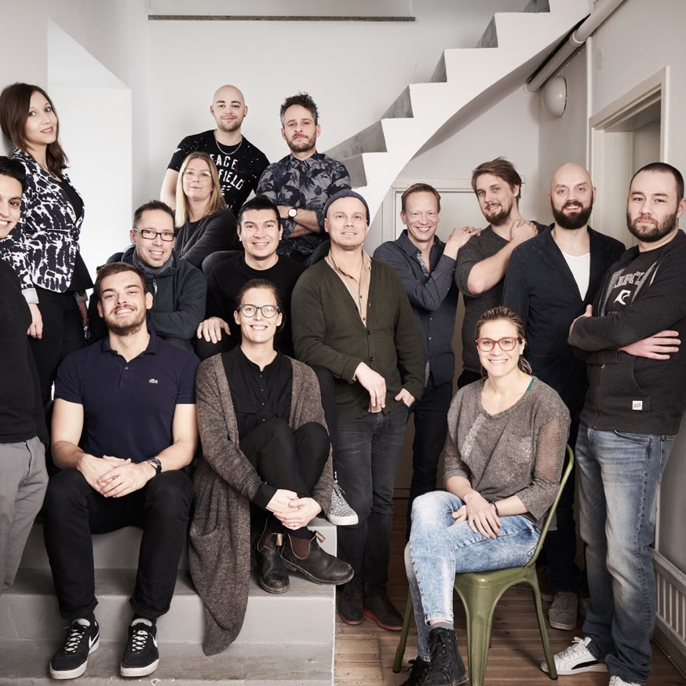
pickit.com
Contact Rob Dysell
T +46 70 468 54 55
M robert.dysell@pickit.com

